Slide 1
Group Members
Mohsin Qamar Khan(Team Leader) 15140104
Usama Imran 15140098
Haider Ali 15140101
Faiza Shanawar 15140070

Slide 2
Global Optimization Using Meta Heuristics
Global optimization
Applications of global Optimization
Meta Heuristics
Proposed Idea
Experimentation And Results
Proposed Application

Slide 3
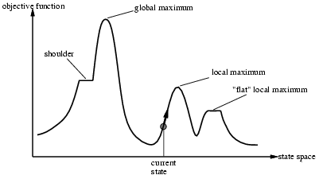
Optimization
mathematical optimization or mathematical programming is the selection of a best element (with regard to some criterion) from some set of available alternatives.
Optimization is the process of finding the point that minimize or maximize a function.

Slide 4
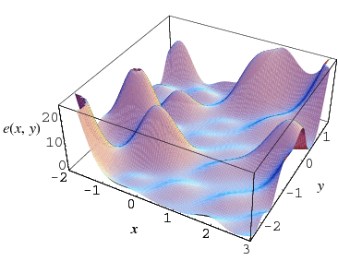
Global Optimization
The objective of global optimization is to find the globally best solution of models, in the (possible or known) presence of multiple local optima. Formally, global optimization seeks global solutions of a constrained optimization model.
global Maxima

Slide 5
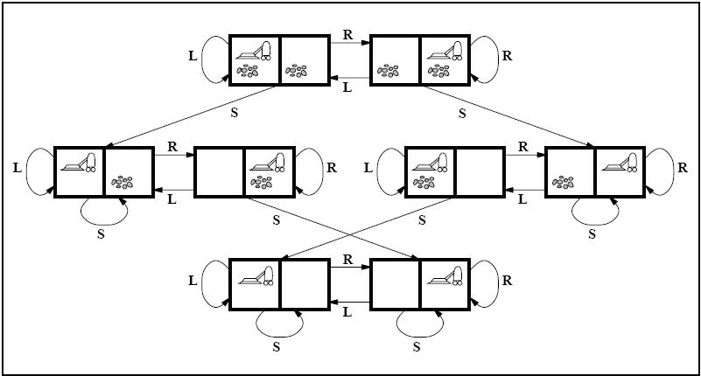
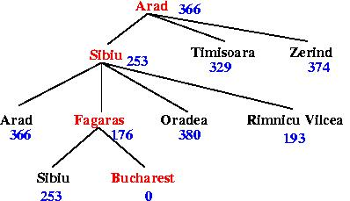
What are Heuristics?
A heuristic is designed to provide better computational performance as compared to conventional optimization techniques, at the expense of lower accuracy.
Heuristic (from Greek εὑρίσκω "I find, discover") is a technique designed for solving a
problem more quickly, or for finding an approximate solution when classic methods.
Examples:
Travelling sales Person (TSP)
Vacuum World problem

Slide 6
What are Meta-Heuristics?
Metaheuristic is a higher-level procedure or heuristic designed to get a sufficiently good
solution to an optimization problem, especially with incomplete or imperfect
information or limited computation capacity.
Examples :
Genetic Algorithm
Simulating Annealing
Particle Swarm Optimization

Slide 7
Difference Between Heuristics and Metaheuristics.
Heuristics are problem depend and the performance varies whereas meta heuristics are
problem independent.
The most important difference between a heuristic and a meta-heuristic is that heuristics get stuck in local optima, while meta-heuristics have mechanism to avoid that.
As examples of this mechanisms, among others, we have:
Mutation (in Genetic Algorithm);

Slide 8
Real World Inspired Algorithms
Human social Behavior
Teacher-learning Algorithm
Swarm Based
Grey Wolf Optimization
Evolutionary Algorithms
Genetic Algorithm

Slide 9
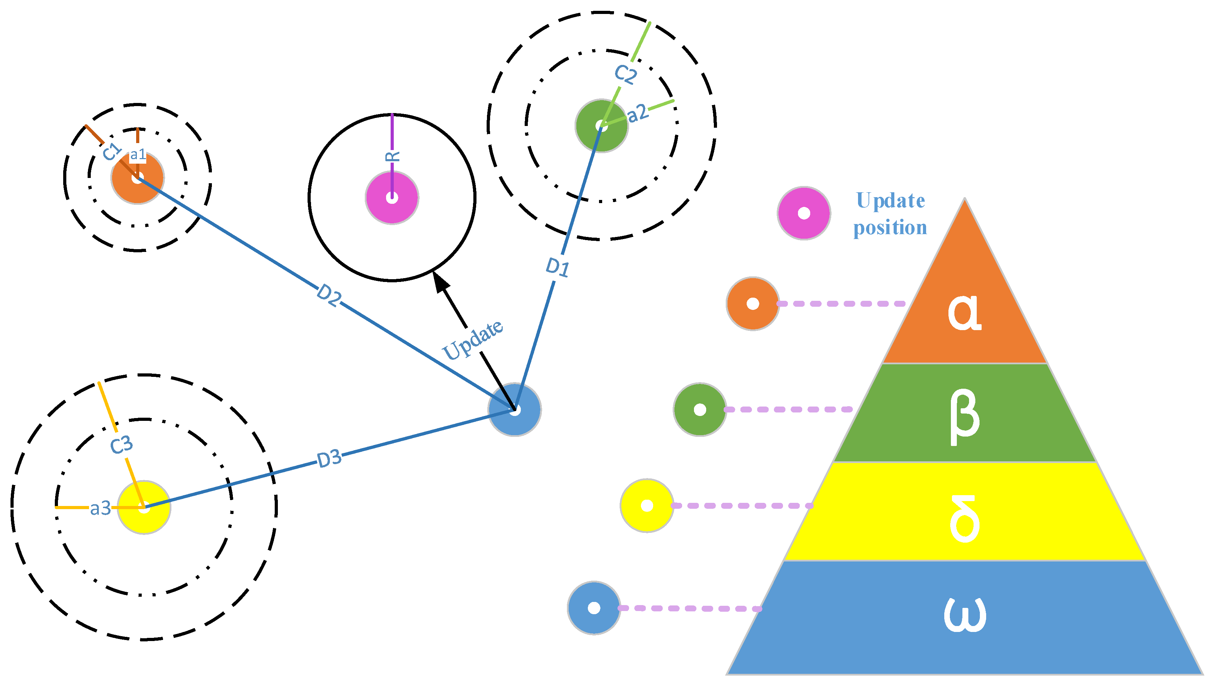
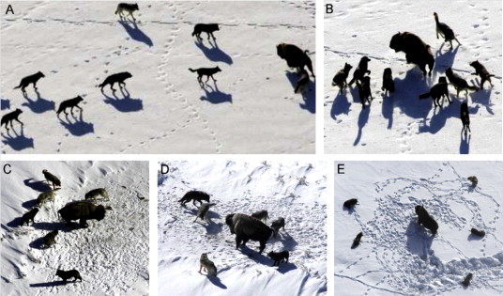
Grey Wolf Optimization
The GWO algorithm mimics the leadership hierarchy and hunting mechanism of Gray Wolf in nature proposed by Mirjalili et al. in 2014.Four types of grey wolves such as alpha, beta, delta, and omega are employed for simulating the leadership hierarchy. In addition, three main steps of hunting, searching for prey, encircling prey, and attacking prey, are implemented to perform optimization.

Slide 10
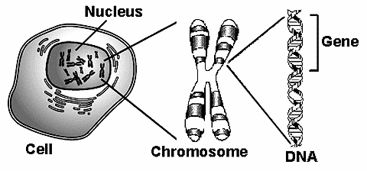
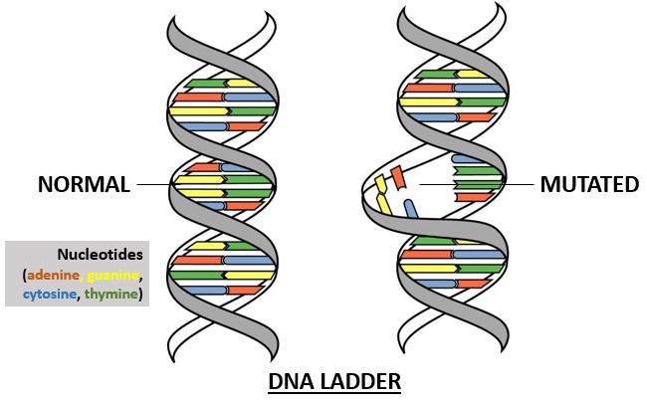
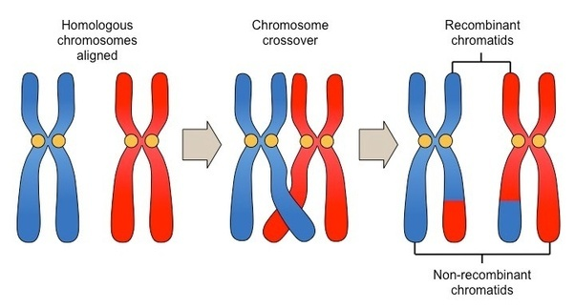
Genetic Algorithm
A genetic algorithm (GA) is a metaheuristics inspired by the process of natural selections that belongs to the larger class of evolutionary algorithms(EA). Genetic algorithms are commonly used to generate high-quality solutions to optimization and search problem by relying on bio-inspired operators such as mutation, crossover and selection.
Mutation
Chromosome crossover

Slide 11

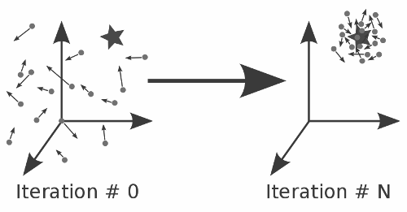
Particle Swarm Optimization
particle swarm optimization (PSO) is a computational method that optimizes a problem by iteratively trying to improve a candidate solution with regard to a given measure of quality.

Slide 12
Benchmark Functions
Optimization test functions, known as artificial landscapes, are useful to evaluate characteristics of optimization algorithms, such as:
Convergence rate
Precision
Robustness
General performance
 | BENCHMARK FUNCTIONS
Adjiman Function | Branin | Booth Function
Brad Function | Cross-in-Tray Function | Ackley
Cube Function | deVilliers Glasser 1

Slide 13
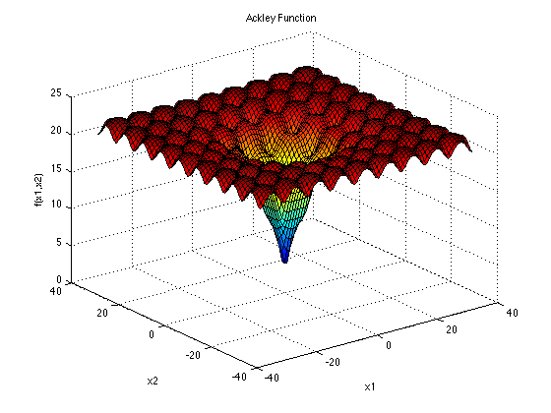
Benchmark Functions
Optimization Test Functions
The Ackley function is widely used for testing optimization
algorithms. In its two-dimensional form, as shown in the plot
above, it is characterized by a nearly flat outer region,
and a large hole at the centre.
The function poses a risk for optimization algorithms,
particularly hillclimbing algorithms, to be trapped in
one of its many local minima.

Slide 14
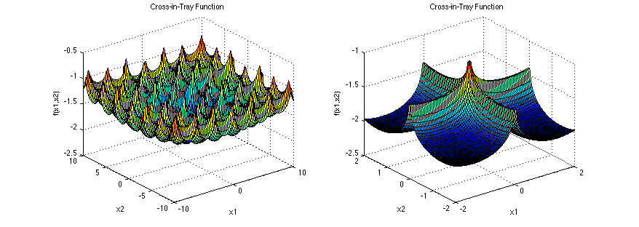
Benchmark Functions
Optimization Test Functions
The Cross-in-Tray function has multiple global minima. It is shown here with a smaller domain in the second plot, so that its characteristic "cross" will be visible.

Slide 15
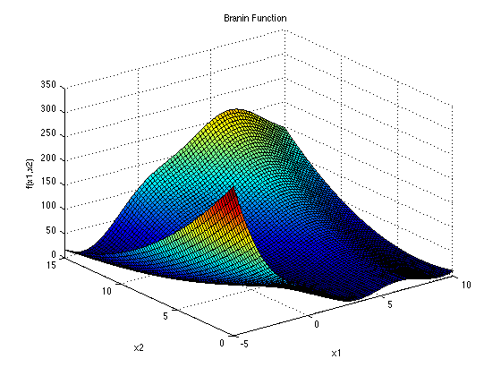
Benchmark Functions
Optimization Test Functions
The Branin, or Branin-Hoo, function has three
global minima.

Slide 16
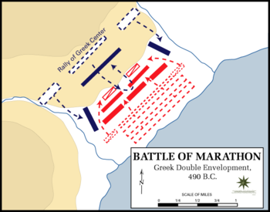
Our Inspiration: War Tactics
We are willing to develop an optimization algorithm. Inspiration we are using is War Tactics. There is no optimization algorithm that is inspired by war tactics according to our knowledge.

Slide 17
Proposed Application
In order to compare our algorithm with other algorithms, we are willing to develop
an application that would be able to compare these algorithms.
User can choose a particular algorithm and set its parameters and similarly, user can
choose second algorithm as well and then their comparison will be shown in the form of graph.
We would also test our algorithm on benchmark functions.

Slide 18

Our Application Inspiration: Weka

